Slide 1
Plant Disease Detection App for Farmers
Group 1
Frank 1930026136
Connor 1930026139
Jorian 1930026170

Slide 2
01
Introduction
02
Dataset and Photos We Collected
TABLE OF CONTENTS
03
Data Prepoccessing
04
Methodology
05
Summary
06
Deployment on Android

Slide 3
01
Introduction

Slide 4
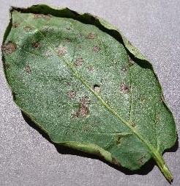
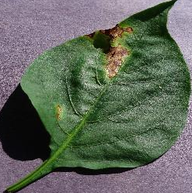
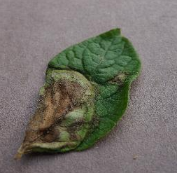
Background Information
Like humans, plants have many different diseases…
As we have learnt many deep learning models, we can develop an app that allows farmers to identify plant health condition/kind of diseases by their.
Early Blight
Bacterial Spot
Late Blight

Slide 5
02
Dataset and Photos We Collected

Slide 6
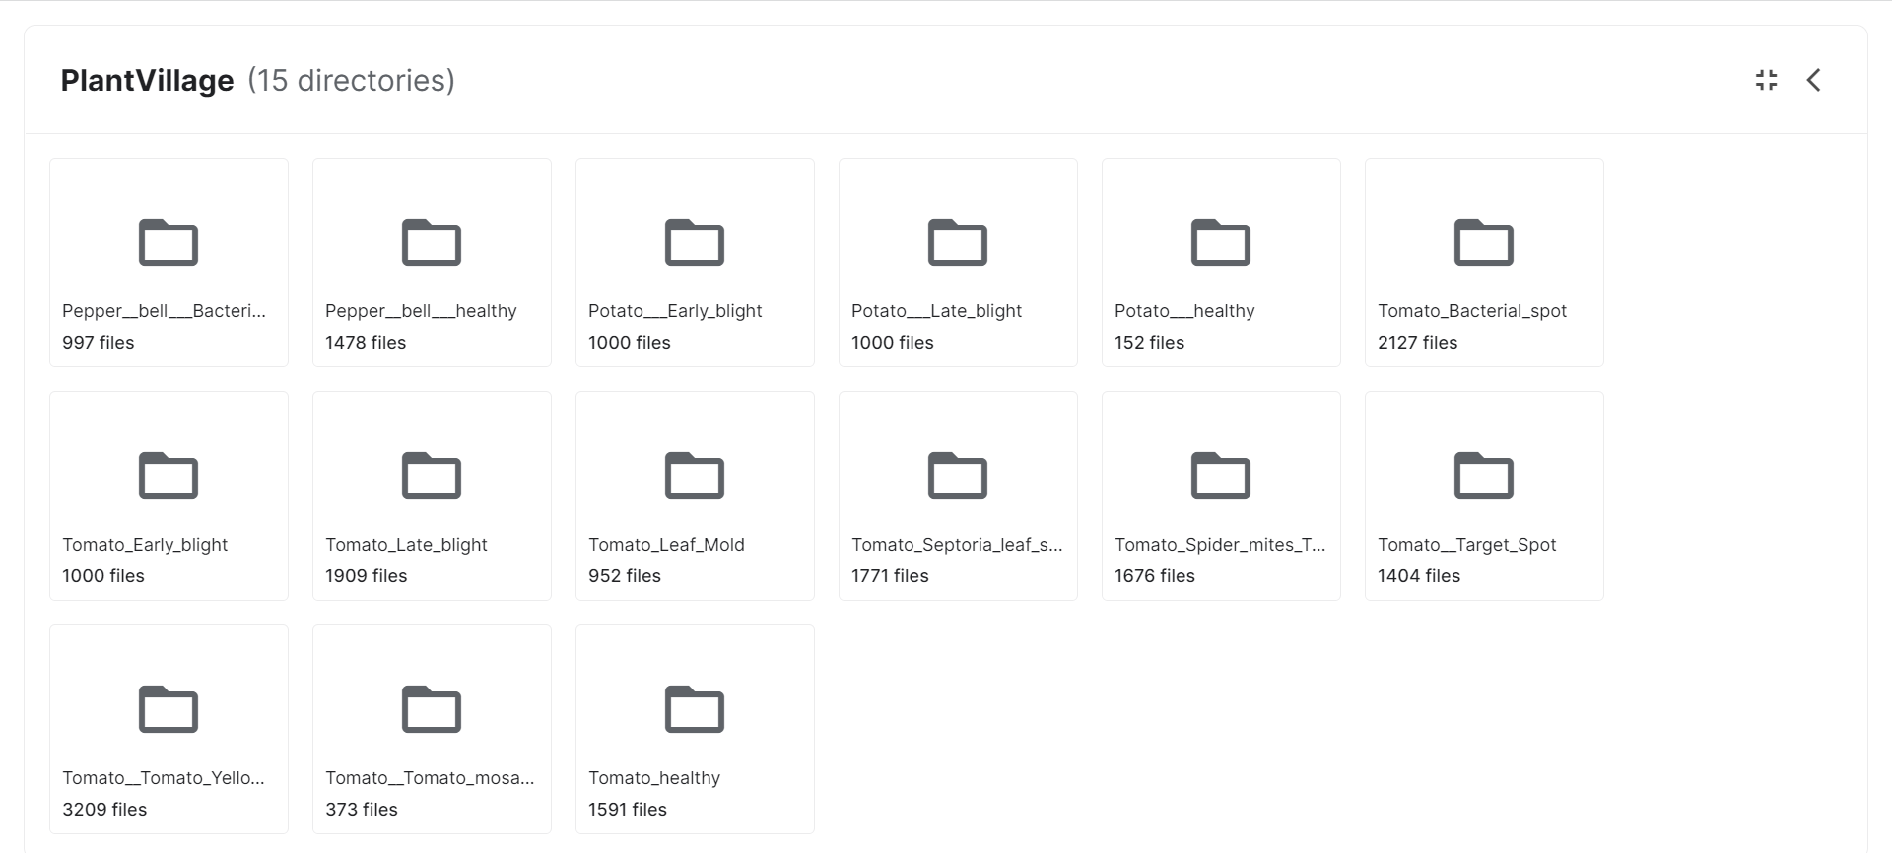
https://www.kaggle.com/datasets/emmarex/plantdisease
More than 24k images !
Classes:
Plant + disease/health condition
'Pepper_bell_Bacterial_spot’
'Pepper_bell_healthy’
'Potato_Early_blight’
'Potato_Late_blight’……

Slide 7
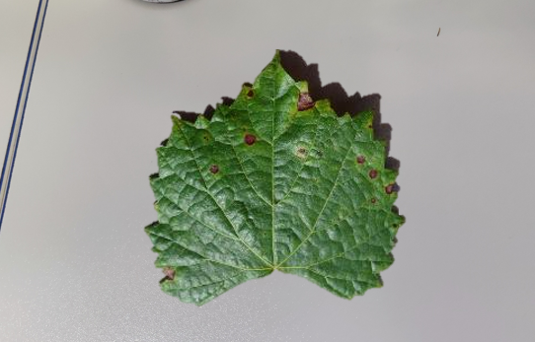
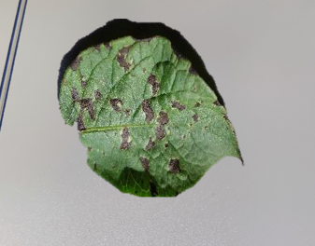
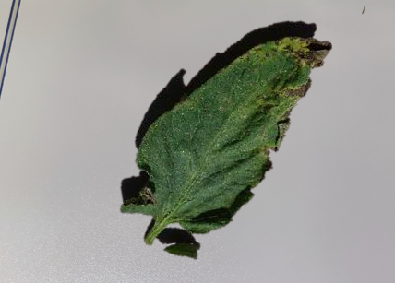
Plants photos in UIC campus

Slide 8
03
Data Prepoccessing

Slide 9
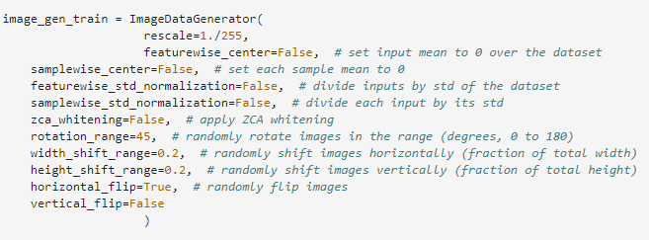
Data Augmentation

Slide 10
04
Methodology

Slide 11
Methodology
LeNet
AlexNet
Baseline:
CNN
Inception
ResNet
Siamese

Slide 12
CNN

Slide 13
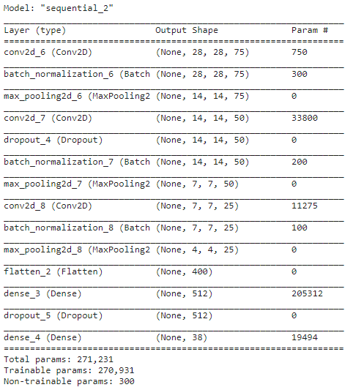

Slide 14
LeNet

Slide 15
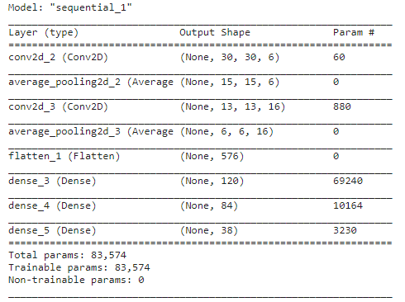
Control output shape via padding, strides and channels
Average Pooling layer

Slide 16
AlexNet

Slide 17
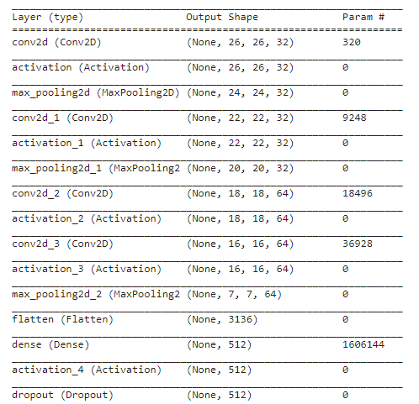
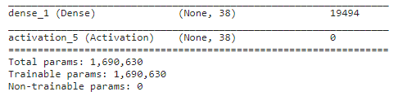
Larger kernel size
Max-pooling
More Conv layers, more output channels

Slide 18
Inception

Slide 19
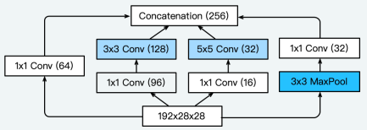
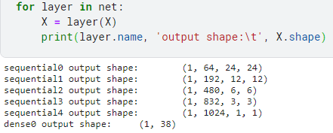
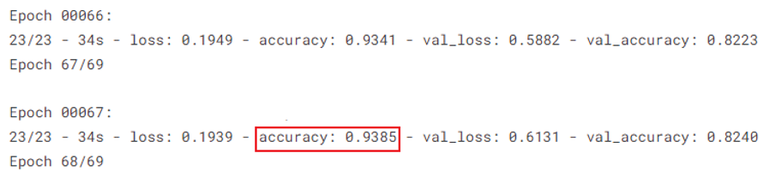
4 channels to extract spatial size convolutions
Concatenate along the output channel
Smaller kernel size with more layers

Slide 20
ResNet

Slide 21
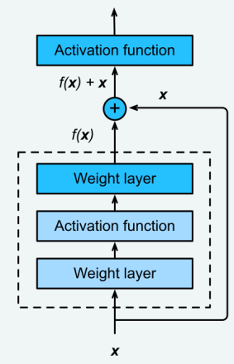
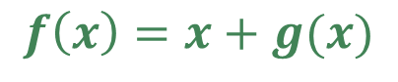
$$f\left(x\right)=x+g(x)$$
Add input to output (transmitted to the next layer without loss)
Solve gradient explosion & vanishing

Slide 22
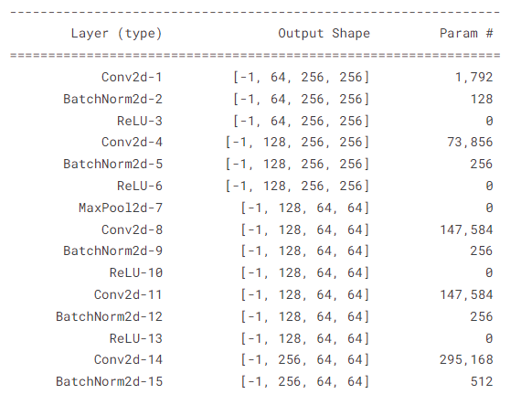
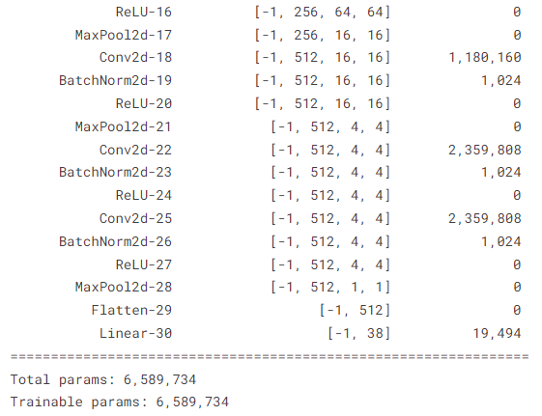

Slide 23
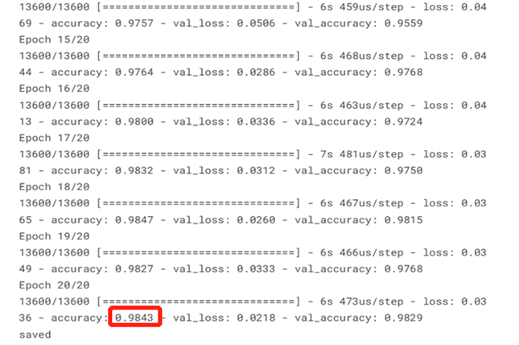
Training Results

Slide 24
Siamese Network

Slide 25
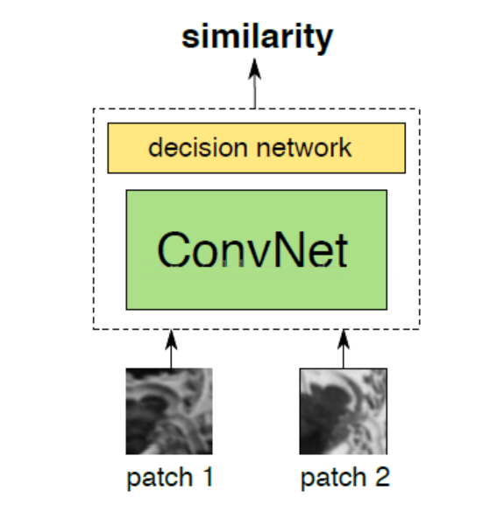
WHAT IS A SIAMESE NETWORK?
Two photos go
through the network separately and extract their feature vectors
Then make a similarity loss function for the 2 vectors to train the network

Slide 26
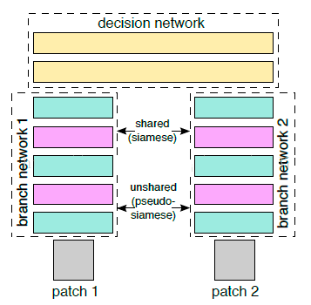
Network Architecture
2 Channels
1 for each patch
Share weights
(except pseudo-Siamese: can be different models)

Slide 27
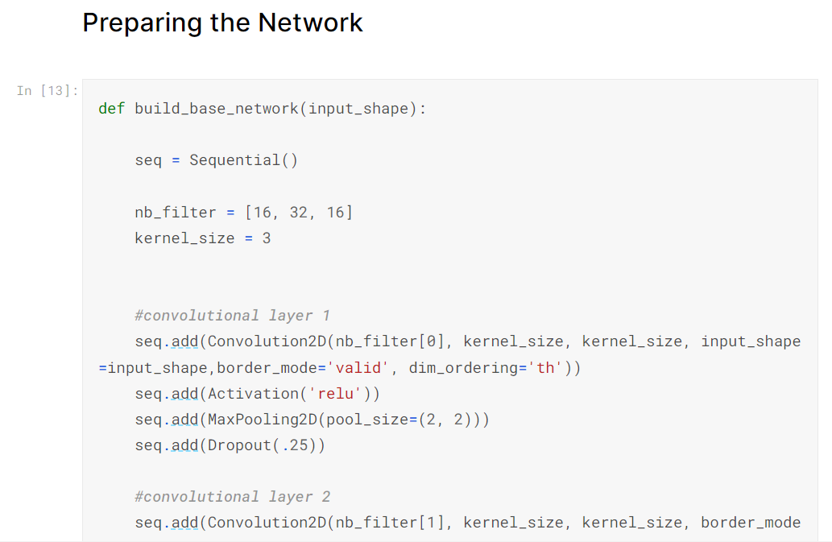
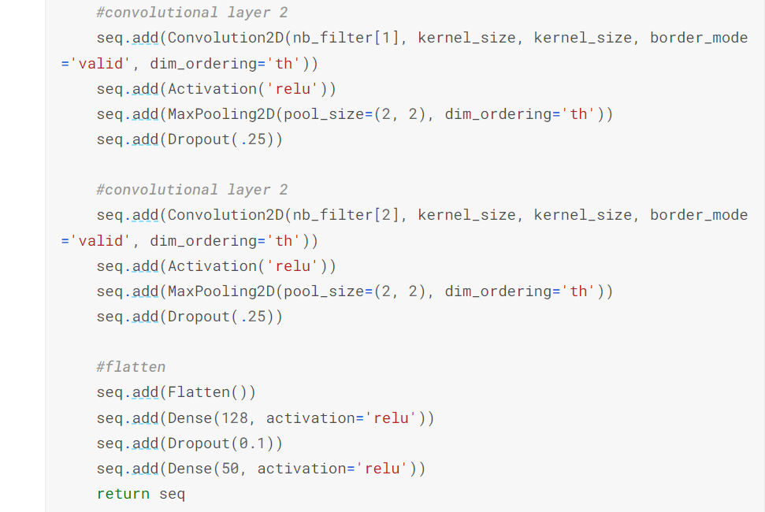
Siamese Network
Define basic network
a convolutional
network used for feature extraction
Build two
convolutional layers
with ReLU,
max pooling,
flat layer

Slide 28
TRAINING RESULTS
SYNONYMS

Slide 29
05
Summarry

Slide 30
 | Accuracy
ResNet | 98.43%
Siamese Network | 96.41%
Inception | 93.85%
AlexNet | 88.37%
CNN | 86.33%
LeNet | 83.30%

Slide 31
06
Deployment on Android

Slide 32
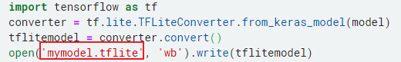
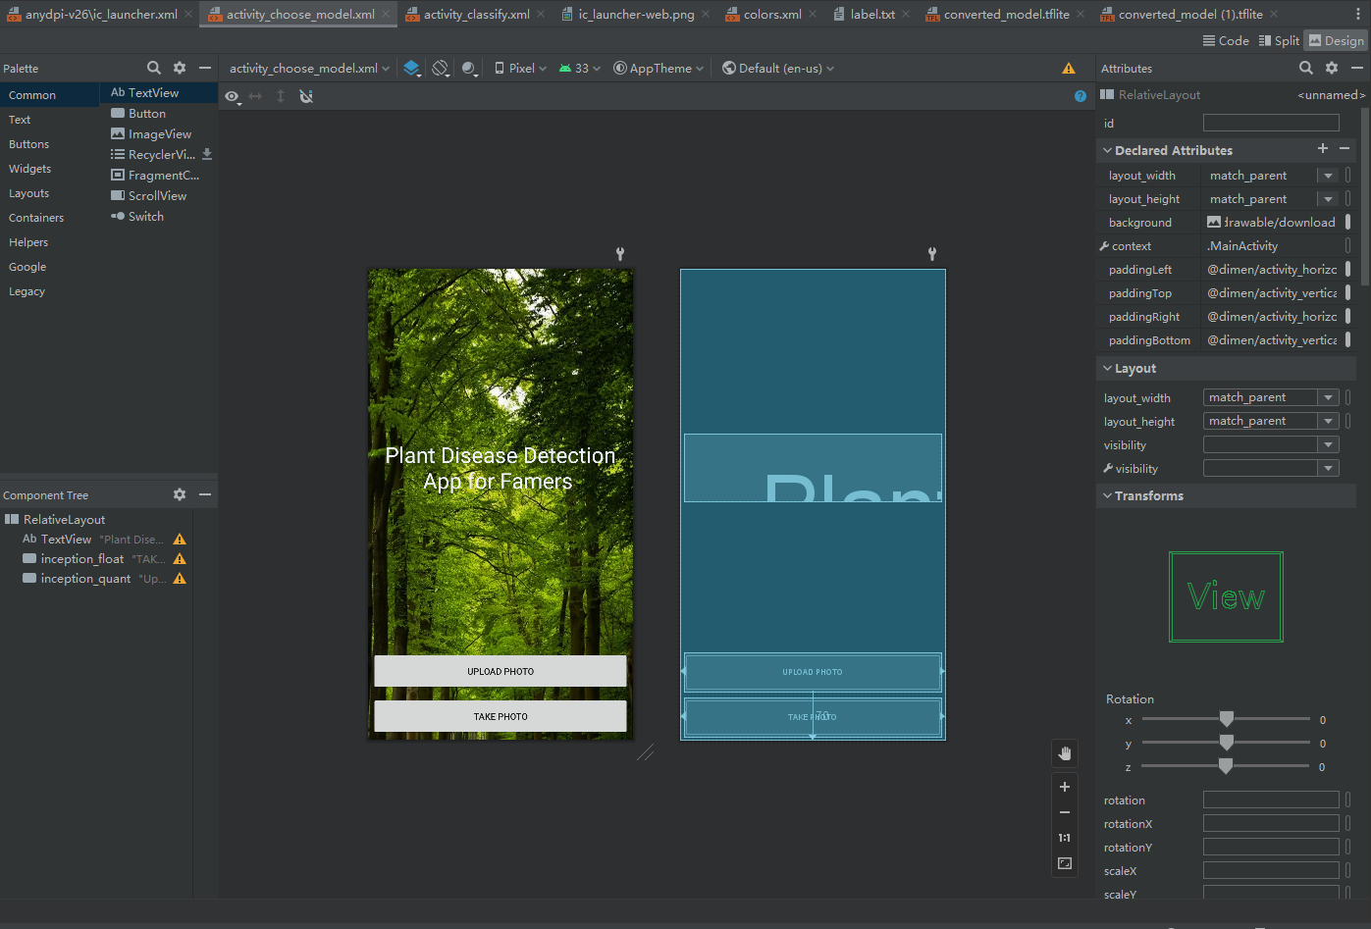

Tflite model

Slide 33
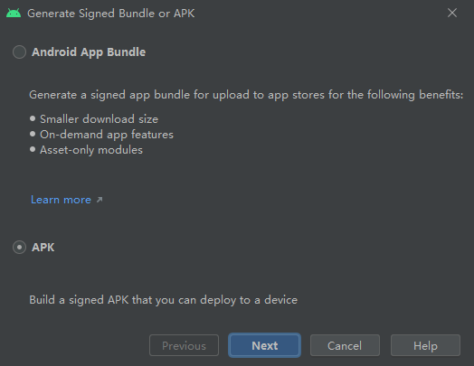
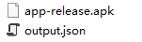
Android Apk

Slide 34
Demo

